Slide 1
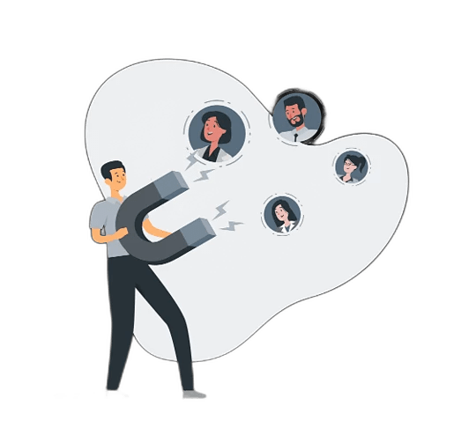

.
AYB Competition
Customer Churn Prediction
Customer Churn Prediction: This clearly identifies the main
topic of the presentation—predicting when and why customers might leave.
Using Data Science to Enhance Customer Retention: Using data science techniques to not only predict churn but also to improve customer loyalty and retention efforts.
MAIN PARTNER

Slide 2
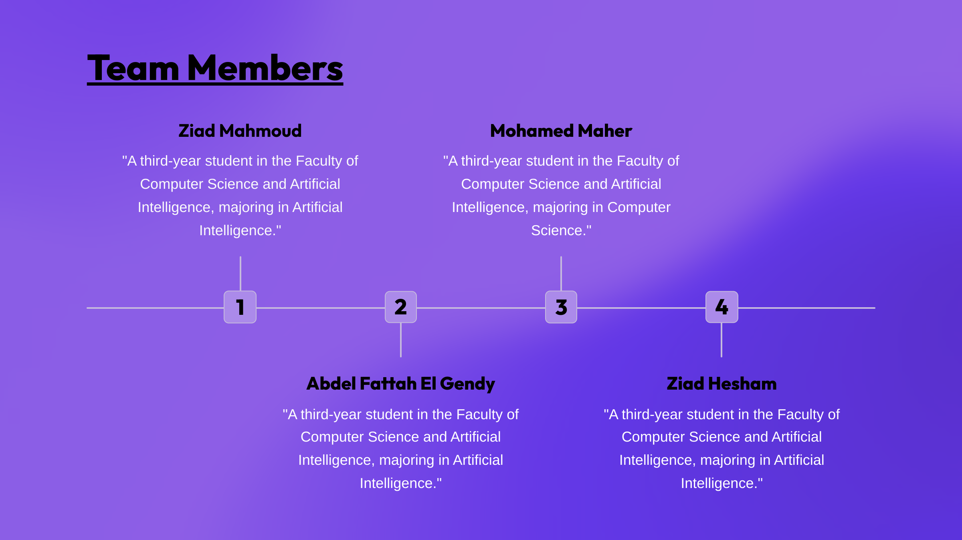
AYB Competition
AYB Competition

Slide 3
AYB Competition
Agenda
1.Introduction & Business Understanding and Problem Overview
2.Data Quality and Key Drivers of Churn
3. Predictive Modeling and Churn Prediction
4.Marketing Strategy for Retention
I will explain the issue of customer churn, its impact on bank profits, and the importance of addressing it.
I will present a marketing campaign aimed at targeting at-risk customers and enhancing retention efforts.
I will discuss the significance of data quality and identify the key factors influencing customer churn.
I will explain how we can use a predictive model to forecast customers at risk of churning.

Slide 4

AYB Competition
Introduction
What is Customer Churn in Banking?
Customer churn in banking occurs when customers close their accounts or reduce their use of the bank’s products and services, such as credit cards
What Does High Churn Mean for Banks?
High customer churn means the bank is losing many customers, which negatively impacts revenue and market share. It also increases costs to acquire new customers
Why is Understanding Churn Important for Banks?
Understanding churn helps banks identify why customers leave and develop strategies to retain them. By analyzing customer behavior and feedback, banks can improve services and enhance customer satisfaction

Slide 5

AYB Competition
Key Issues
Churn Triggers in Banking:
Churn can be triggered by interactions between customers and the bank’s products or services, such as dissatisfaction with fees, service quality, or lack of personalized offerings.
Maximizing Customer Retention for Profit:
The bank’s focus is to retain as many customers as possible to increase profitability, as loyal customers generate consistent revenue.
Challenges in Identifying Churn Causes:
Banks often struggle to pinpoint the exact reasons why customers leave, making it difficult to implement effective retention strategies and keep existing customers engaged.
Learn More

Slide 6
AYB Competition
Objectives
01
Identify Churn Drivers
Analyze customer data (demographic, financial, and behavioral) to understand the key factors that lead to customer churn.
Creative Solution
Develop Predictive Models
Develop Predictive Models
02
Build a machine learning model to accurately predict which customers are most likely to churn.
Marketing Strategy
Identify Churn Drivers
Improve Customer Retention
03
Implement targeted strategies based on model insights to retain at-risk customers and reduce churn rates.
Digital Advertising
Enhance Customer Engagement:
Improve Customer Retention
04
Personalize customer interactions and offerings to increase satisfaction and loyalty, minimizing future churn

Slide 7
AYB Competition
Exploratory Data Analysis (EDA)
1.Data Quality Checks
Missing Value
Data types
Outliers
Check for inconsistencies or incorrect entries
Check for any duplicate entries
Identify missing or null values in the dataset.
Ensure that each column has the correct data type.
Detect potential outliers in numerical columns.
Duplicate records
Inconsistent data

Slide 8
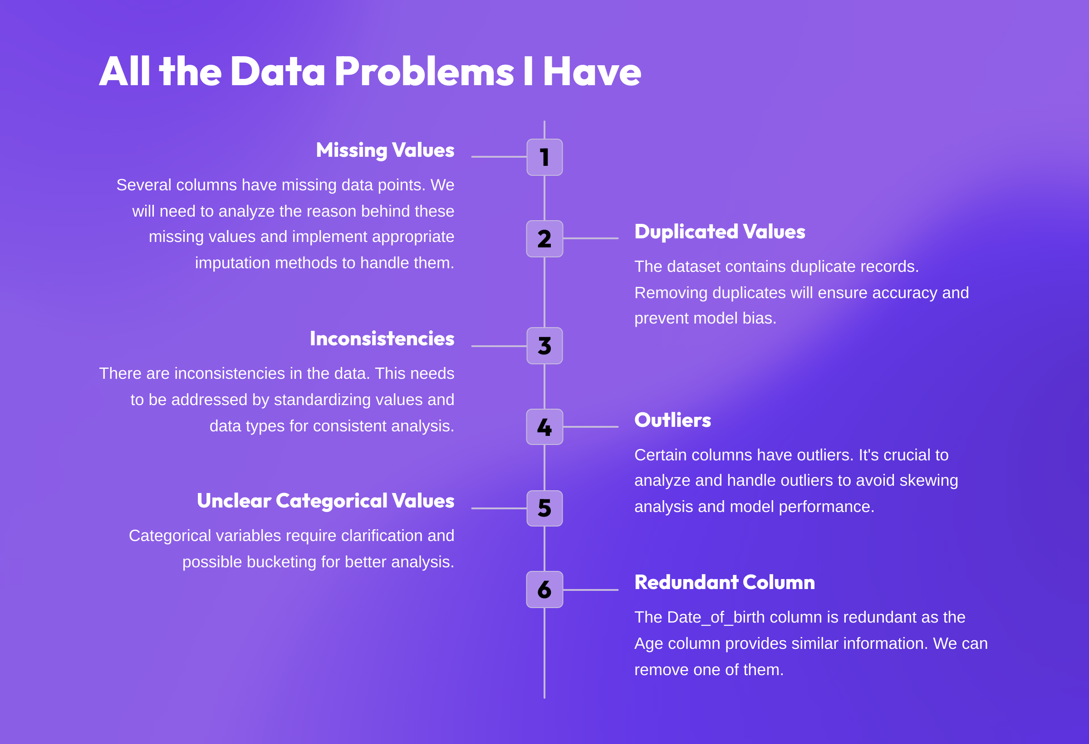
AYB Competition

Slide 9

Applying Machine Learning Algorithms
Logistic Regression
Random Forest

Slide 10
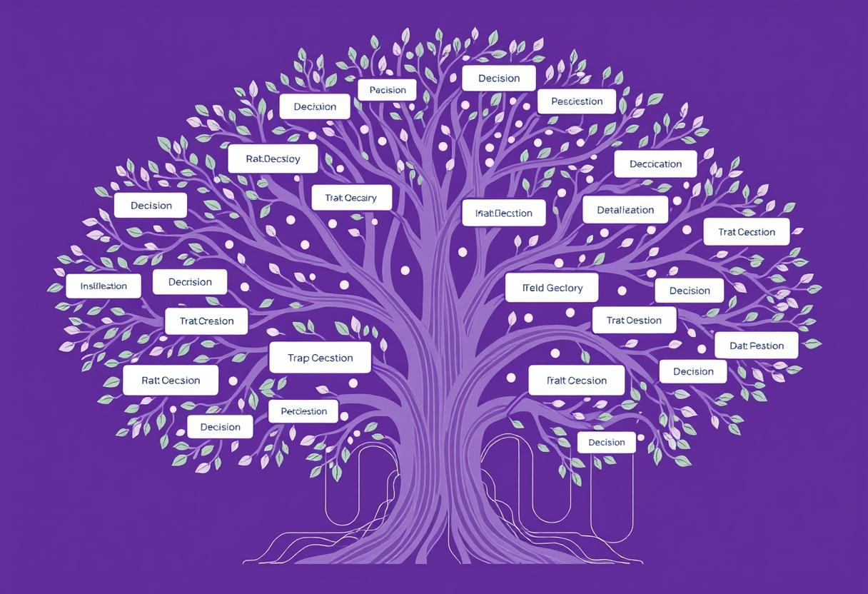
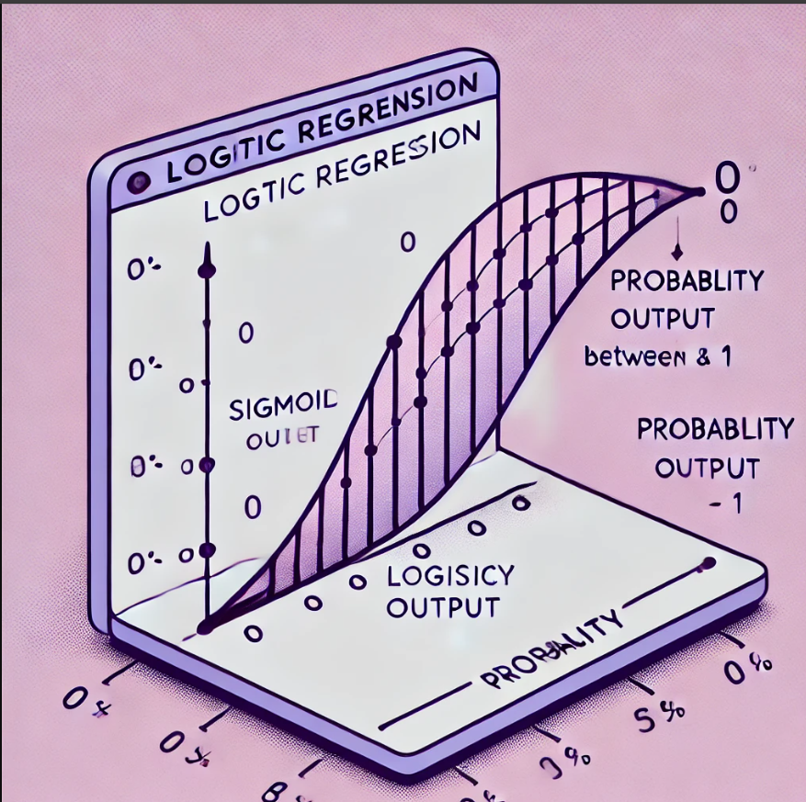
AYB Competition
Our Vision
Random Forest
Logistic Regression
Why it's good: Random Forest is an ensemble learning method that works well for classification problems like churn prediction. It can handle a variety of data types (numerical, categorical) and is robust against overfitting.
Advantage: High accuracy and ability to capture complex patterns in customer behavior.
Provides feature importance, helping to identify key factors contributing to churn.
Works well with imbalanced datasets (common in churn scenarios).
Why it's good: Logistic Regression is simple and interpretable, making it ideal for understanding the relationships between variables and churn. Advantage: Easy to interpret, allowing for clear insights into which factors drive churn.
Efficient with large datasets and quick to implement.
Provides probabilities, helping to prioritize customers based on churn risk.

Slide 11
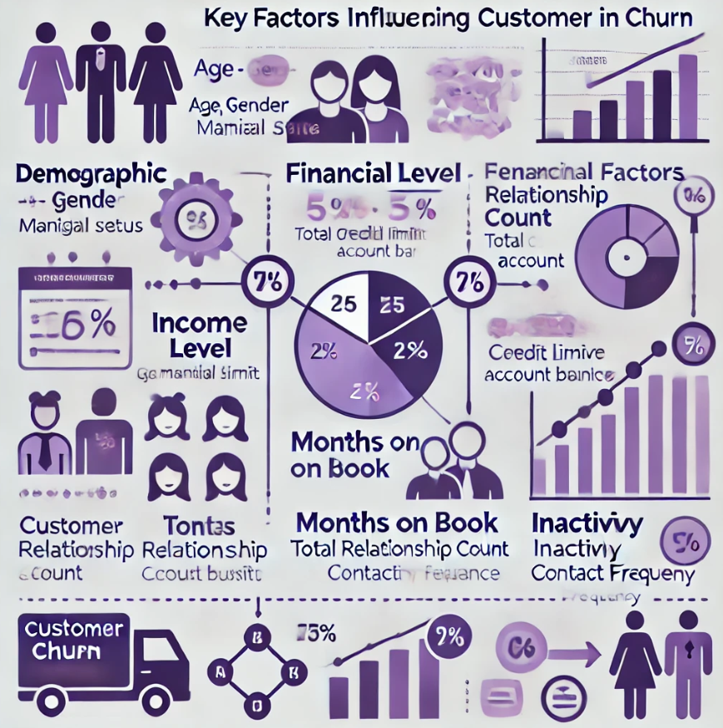
Key Factors Influencing Customer Retention
01
Demographic Factors
02
Financial Factors
03
Behavioral Factors

Slide 12
1. Demographic Factors
Age: Different age groups may have varying levels of loyalty to the bank.
Gender: There may be differences in churn rates between male and female customers.
Marital Status: Single customers might be more loyal compared to Married customers.
2. Financial Factors
Income Level: Customers with higher income levels may have lower churn rates due to greater financial stability.
Account Balances: Larger account balances can indicate more engaged customers.
Transaction Patterns: More frequent transactions may signal stronger engagement and lower churn risk.
3. Behavioral Factors
Months on Book: The longer a customer has been with the bank, the more likely they are to stay.
Total Relationship Count: Customers with multiple products and services are generally more loyal.
Inactivity: Longer periods of inactivity increase the risk of churn.
Contact Frequency: Regular communication can enhance customer retention and loyalty.

Slide 13

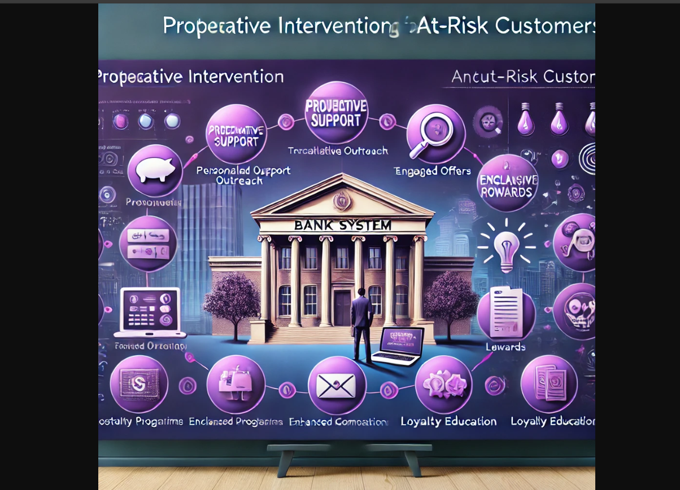




Proactive Intervention: Retaining At-Risk Customers
Personalized Outreach
Target at-risk customers with tailored offers and promotions.
Enhanced Communication
Increase communication frequency and provide proactive support.
Loyalty Programs
Offer exclusive benefits and rewards to foster loyalty.
Customer Education
Educate customers on ways to maximize their banking experience.

Slide 14

AYB Competition
Returning Customer Analysis
Customer Segment
Criterion
High Risk
Churn probability>0.75
Medium Risk
Churn probability>0.50
Low Risk
Churn probability<0.50

Slide 15
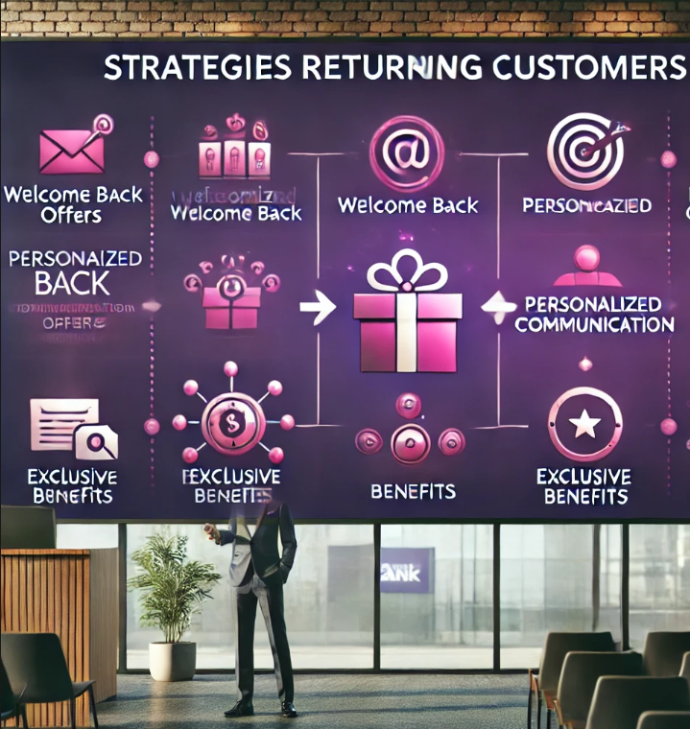
AYB Competition
Strategies for Returning Customers
Welcome Back Offers
Provide incentives for reactivation.
Personalized Communication
Tailor messages to individual customer needs.
Exclusive Benefits
Offer special perks for returning customers.

Slide 16
AYB Competition
Churners Marketing Campaign: Winning Them Back
Campaign Segmentation
1
Identify distinct churner segments with tailored messages.
2
Channel Selection
Leverage email, SMS, app notifications,
and personalized mailers.
Messaging Strategy
3
Emphasize value proposition, benefits, and incentives.
4
Call to Action
Encourage customers to re-engage with the bank.
Campaign Monitoring
5
Track performance through KPIs and adjust strategies as needed.

Slide 17

Measuring Campaign Success: Key Performance Indicators (KPIs)
1
Conversion Rate
Percentage of churners who re-engage.
2
Customer Retention Rate
Proportion of churners retained after the campaign.
3
Average Revenue Per User (ARPU)
Average revenue generated from reactivated customers.
4
Customer Satisfaction Scores
Assess customer satisfaction with the campaign and its impact on their banking experience.

Slide 18
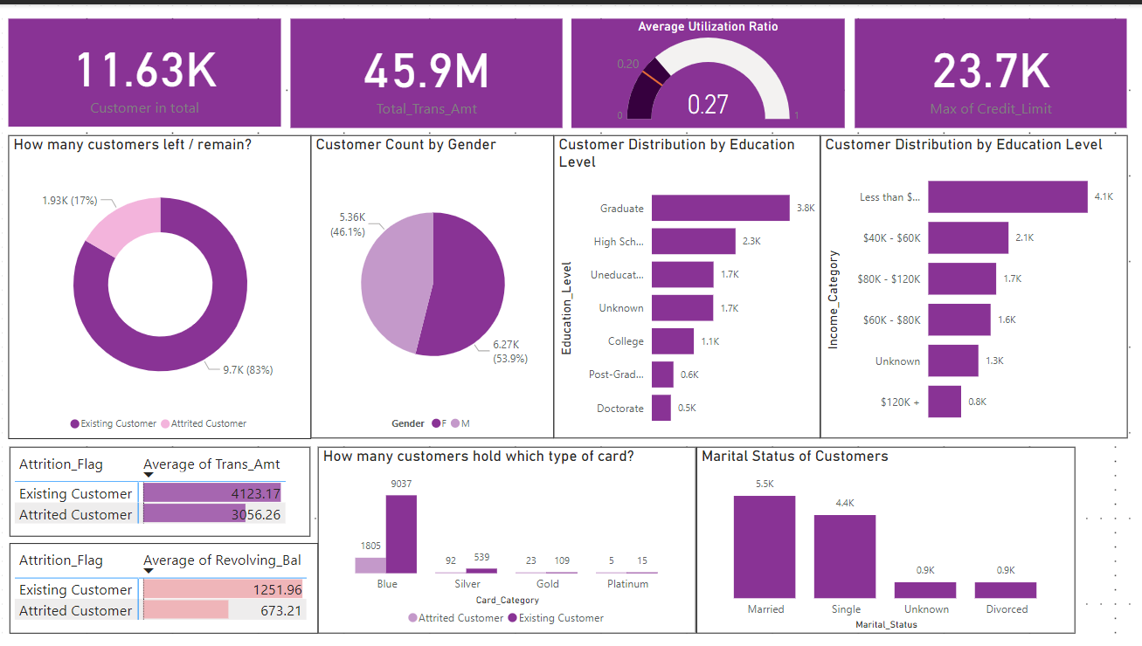
AYB Competition
Our Infogaphic
Company Infographic
Customer Retention
Card Popularity
Out of 11.63K customers, 83% remain loyal to the company, while 17% have left. This indicates a strong customer retention rate, which is crucial for business growth.
The Blue card is the most popular, held by 9,037 customers, while other cards like Gold and Platinum have significantly fewer holders. This reflects customer preferences for simpler card options.
Customer Distribution by Education
Credit Limit and Utilization
The largest group of customers are graduates (3.8K), followed by high school graduates (2.3K). This suggests that the company appeals to a well-educated customer base.
Customers have a maximum credit limit of 23.7K, with an average utilization ratio of 0.27. This indicates customers are using about 27% of their available credit, which suggests responsible credit usage.

Slide 19
AYB Competition
Our Customer Analysis
4542
5158
Income Level and Loyalty
The majority of customers earn less than $40K, with 3,367 existing customers and 726 attrited. Interestingly, customers with higher incomes (over $120K) show lower attrition, indicating that wealthier customers are generally more loyal.
Gender Distribution and Attrition
The company has more female customers (5,158) than male customers (4,542). However, attrition is also higher among females, with 1,108 females leaving compared to 817 males.

Slide 20

AYB Competition
I would like to extend my heartfelt thanks to everyone for your time and attention today.
A special thank you to the organizers for making this presentation possible. Let’s keep building strong relationships for a successful future!
AYB

